Slide 1

Welcome to Spring 3.0 Chapter 4 – Data Access

Slide 2
Chapter 4 – Data Access
The Service Layer(data tier) | DataAccess with JDBC
 | Transaction Management
 | Integrating Spring with JPA
 | Integrating Spring with JDO
 | Marshalling XML using O/X Mappers
 | Integrating Spring with Hibernate
 | Mini Project

Slide 3
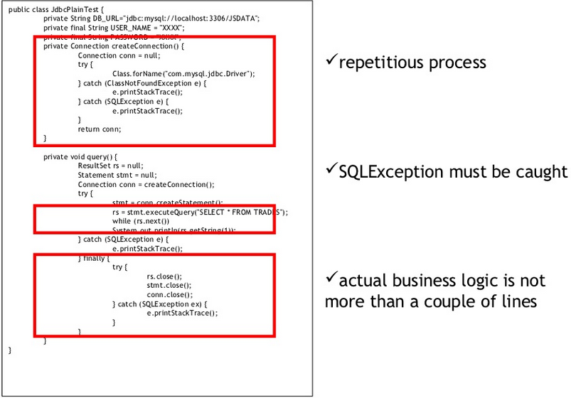
Plain JDBC

Slide 4
JDBC API
The problems of JDBC API are as follows:
We need to write a lot of code before and after executing the query, such as creating connection, statement, closing resultset, connection etc.
We need to perform exception handling code on the database logic.
We need to handle transaction.
Repetition of all these codes from one to another database logic is a time consuming task.
Spring JdbcTemplate eliminates all the above mentioned problems of JDBC API. It provides you methods to write the queries directly, so it saves a lot of work and time.

Slide 5
Spring JDBC
Who does what?
Action | Spring | You
Define connection parameters. |  | X
Open the connection. | X
Specify the SQL statement. |  | X
Declare parameters and provide parameter values |  | X
Prepare and execute the statement. | X
Set up the loop to iterate through the results (if any). | X
Do the work for each iteration. |  | X
Process any exception. | X
Handle transactions. | X
Close the connection, statement and resultset. | X

Slide 6
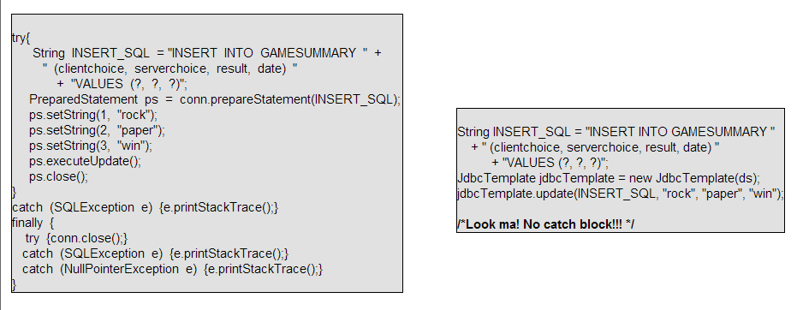
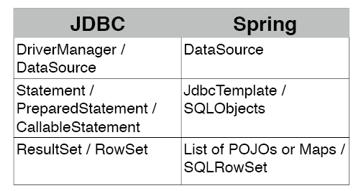
Spring JDBC

Slide 7
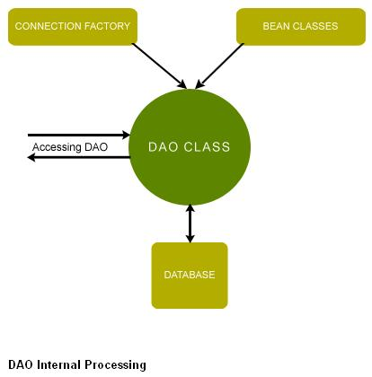
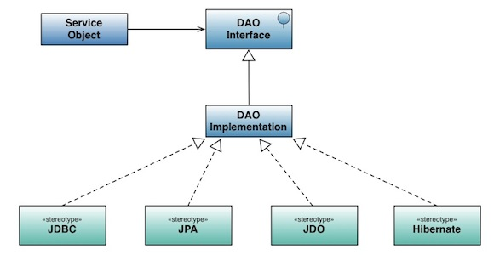
DAO
Application is independent of the Data access techniques and database dependency.
Offers loose coupling with the other layers of application.
Allows to unit test the service layer using mock objects with out connecting to database.

Slide 8
Spring Options/Styles
13.1.1 Choosing a style
There are a number of options for selecting an approach to form the basis for your JDBC database access. There are three flavors of the JdbcTemplate, a new "SimpleJdbc" approach taking advantage of database metadata, and there is also the "RDBMS Object" style for a more object oriented approach similar in style to the JDO Query design. We'll briefly list the primary reasons why you would pick one of these approaches. Keep in mind that even if you start using one of these approaches, you can still mix and match if there is a feature in a different approach that you would like to take advantage of. All approaches requires a JDBC 2.0 compliant driver and some advanced features require a JDBC 3.0 driver.
JdbcTemplate - this is the classic Spring JDBC approach and the most widely used. This is the "lowest level" approach and all other approaches use a JdbcTemplate under the covers. Works well in a JDK 1.4 and higher environment.
NamedParameterJdbcTemplate - wraps a JdbcTemplate to provide more convenient usage with named parameters instead of the traditional JDBC "?" place holders. This provides better documentation and ease of use when you have multiple parameters for an SQL statement. Works with JDK 1.4 and up.
SimpleJdbcTemplate - this class combines the most frequently used features of both JdbcTemplate and NamedParameterJdbcTemplate plus it adds additional convenience by taking advantage of some Java 5 features like varargs, autoboxing and generics to provide an easier to use API. Requires JDK 5 or higher.
SimpleJdbcInsert and SimpleJdbcCall - designed to take advantage of database metadata to limit the amount of configuration needed. This will simplify the coding to a point where you only need to provide the name of the table or procedure and provide a Map of parameters matching the column names. Designed to work together with the SimpleJdbcTemplate. Requires JDK 5 or higher and a database that provides adequate metadata.
RDBMS Objects including MappingSqlQuery, SqlUpdate and StoredProcedure - an approach where you create reusable and thread safe objects during initialization of your data access layer. This approach is modeled after JDO Query where you define your query string, declare parameters and compile the query. Once that is done any execute methods can be called multiple times with various parameter values passed in. Works with JDK 1.4 and higher.

Slide 9
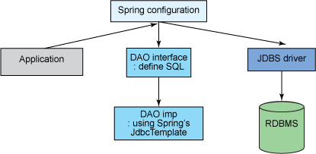
Spring JDBCTemplate

Slide 10
JdbcDaoSupport
To obtain the JdbcTemplate object we have used getJdbcTemplate() method provided by JdbcDaoSupport Class.
public class IssuesDaoImpl extends JdbcDaoSupport implements IssuesDao{

Slide 11
SimpleJDBCTemplate

Slide 12
JDO

Slide 13
Spring
JDO
JPA
HIBERNATE

